Slide 1
IST687 – Applied Data Science
Chapter 16
Lining Up Our Models

Slide 2

Data Science
Data users are often interested in questions about relationships and prediction. For example, ‘does X influence Y’. In this chapter, we introduce modeling and the techniques of linear regression, a very important data science tool.

Slide 3
Data Science
Chapter Objectives
Be able to create a ‘model’ for a given dataset and then use the model to interpret/understand the data
Identifying relationships between variables in one or more data sets
Visually and statistically determining the influence of one or more variables over another
Interpret the statistical output of a linear regression model
Evaluate how 'least squares' formula can be used to predict dependent variable
Utilize appropriate R code to:
plot dependent and independent variables
create a fitted 'least squares' line

Slide 4
Data Science
So Many Models
Someone who appears in magazines?
A small car or railroad?
A Data Model (such as an ERD)?
An “object” created in R that we can use for data understanding and data prediction

Slide 5
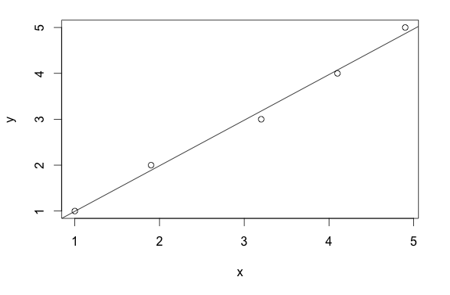
Data Science
A Linear Model
used for prediction (kind of like extrapolation)
Note that:
- It’s not “perfect”
- Minimize “distance” from points to the line
Y = MX + B
Notes:
The chart shows how the relationship between an input (independent) variable – on the horizontal x-axis – relates to the output (dependent) values on the y-axis. In other words, the output variable is dependent (is a function of) the independent variable.

Slide 6
Data Science
Chapter Example
Car maintenance (how often to change the oil)
We manage a “fleet” of cars
Cars get replaced every three years
Have information on past repairs, miles driven and number of oil changes during past three years
Can we build a model to predict the cost of repairs?

Slide 7
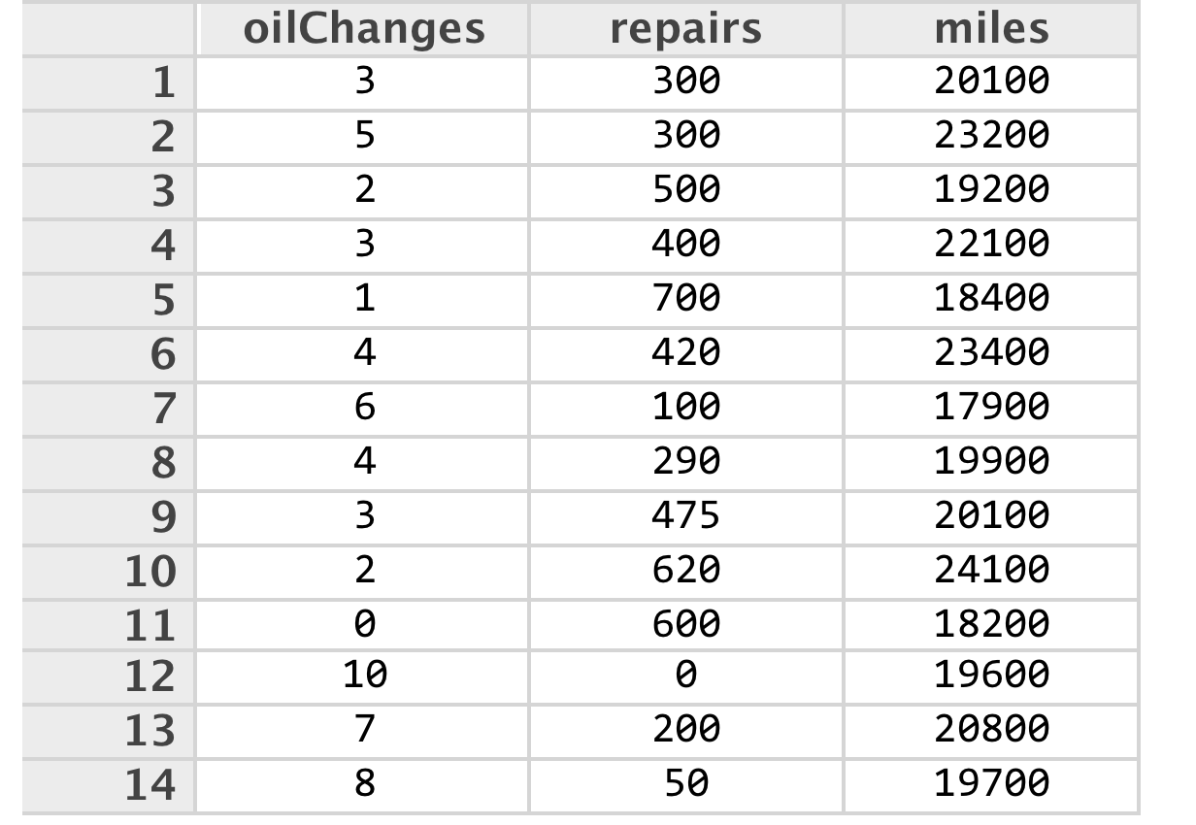
Data Science
Data for analysis
Notes:
Which are independent (oil change, miles) and which are dependent (repairs)?

Slide 8
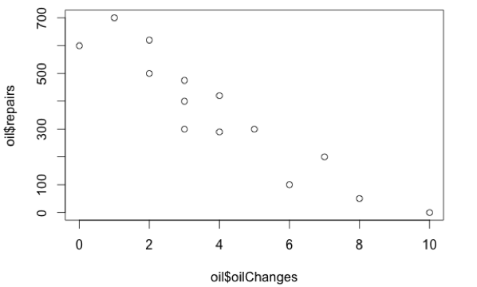
Data Science
> plot(oil$oilChanges, oil$repairs)
Dependent
Variable
Independent
Variable

Slide 9
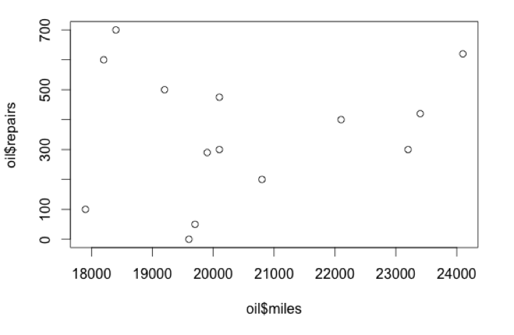
Data Science
> plot(oil$miles, oil$repairs)
Dependent
Variable
Independent
Variable

Slide 10
Data Science
> model1 <- lm(formula=repairs ~ oilChanges, data=oil)
> summary(model1)
Call:
lm(formula = repairs ~ oilChanges, data = oil)
Residuals:
Min 1Q Median 3Q Max
-136.208 -48.195 -0.211 54.782 119.803
Coefficients:
Estimate Std. Error t value Pr(>|t|)
(Intercept) 652.191 40.537 16.089 1.74e-09 ***
oilChanges -71.994 8.202 -8.778 1.44e-06 ***
---
Signif. codes: 0 ‘***’ 0.001 ‘**’ 0.01 ‘*’ 0.05 ‘.’ 0.1 ‘ ’ 1
Residual standard error: 82.72 on 12 degrees of freedom
Multiple R-squared: 0.8653, Adjusted R-squared: 0.854
F-statistic: 77.05 on 1 and 12 DF, p-value: 1.436e-06
Notes:
The r squared value – the coefficient of determination – represents the proportion of the variation which is accounted for in the dependent variable by the whole set of independent variables (in this case just one independent variable).

Slide 11
Data Science
Summary(model1) interpretation
R-squared value 0.8653
The proportion of the variation which is accounted for in the dependent variable by the whole set of independent variables
The closer to 1.0 , the greater the influence the independent variable has on predicting the value of the dependent variable
The r squared value of .8653 indicates that the oil changes accounts for 86.53% of the cost of repairs

Slide 12
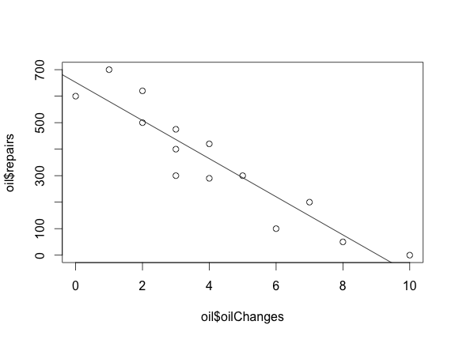
Data Science
abline(model1)
Line of best fit
Notes:
The model above suggests that we should do as many oil changes as possible. For example, it predicts very low (almost 0) repairs if we do 9 or more oil changes, but about $680 if we do no oil changes.

Slide 13
Data Science
What if oil changes cost $350 each?
> oil$oilChangeCost <- oil$oilChanges * 350
> oil$totalCost <- oil$oilChangeCost + oil$repairs
> m <- lm(formula=totalCost ~ oilChanges, data=oil)
> plot(oil$oilChanges, oil$totalCost)
> abline(m)

Slide 14
Data Science
What if oil changes cost $350 each?
> oil$oilChangeCost <- oil$oilChanges * 350
> oil$totalCost <- oil$oilChangeCost + oil$repairs
> m <- lm(formula=totalCost ~ oilChanges, data=oil)
> plot(oil$oilChanges, oil$totalCost)
> abline(m)

Slide 15
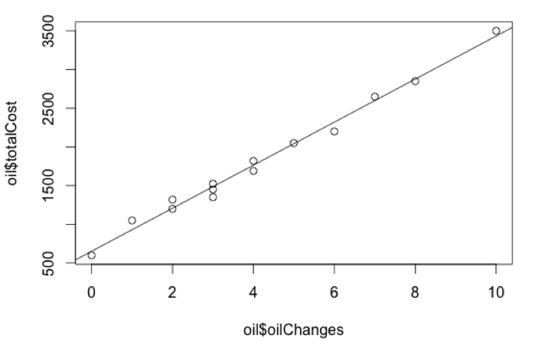
Data Science
What if oil changes cost $350 each?

Slide 16
Data Science
Prediction Equation
> test = data.frame(oilChanges=0)
> predict(m,test, type="response")
652.191
> test = data.frame(oilChanges=5)
> predict(m,test, type="response")
2042.219
> test = data.frame(oilChanges=10)
> predict(m,test, type="response")
3432.247

Slide 17
Data Science
How accurate is the model?
Did we have all the facts?
Did we have all the data?
Notes:
perhaps there was additional maintenance done on the car beyond oil changes
we would likely not use the extreme number (such as zero or 10 oil changes)

Slide 18
IST687 – Applied Data Science
End of Chapter 16

